Slide 1
Welcome to Organic Chemistry The Chemistry of Life
Chemistry 51A
Professor Weiss

Slide 2
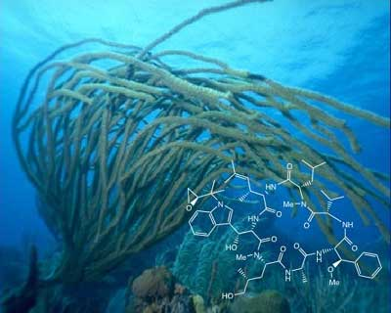
Week 1
Assigned reading: 1.1 to 1.13
(Weekly) Homework: (to be completed by Monday, Oct. 8th)
1.2, 1.3 to 1.36 (parts a and b, where applicable), 1.40, 1.42, 1.55, 1.62, 1.84
All problems in reading material and the problems specified on the website
Chapter 1: Structure and Bonding
Cycolomarin is a novel cyclic peptide isolated from a marine actinomycete collected in a sediment sample from Mission Bay, California.
http://www.chem.upenn.edu/chem/research/organic.php

Slide 3
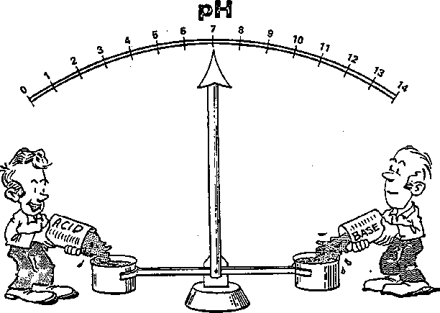
Week 2
Assigned reading: 2.1 to 2.8
Homework: Ch. 2 (due Oct. 10th)
2.1-2.12, 2.14-2.16, 2.19-2.20, 2.22-2.26, 2.30-2.33, 2.35, 2.38-2.41, 2.44, 2.50-2.51, 2.57, 2.68, 2.78
All problems in reading material and the problems specified on the website
Chapter 2: Acids and Bases
Brønsted-Lowry and Lewis
Chapter 3: Alkanes

Slide 4
Office hours
Professor Weiss (4122 NS-1)
Tuesdays 10:30-11:30 am
Wednesdays, 11:15 am - 12:15 pm
Floating OH Week 1: Thursday, 1:30-2:30 pm
Floating OH Week 2: Friday 11-noon
Teaching Assistants
Ryan Le Tourneau (Office hours: Mondays 3:00-4:00 pm, location: RH 523 )
Aoon Rizvi (Office hours: Tuesdays 3-4 pm, location: RH 228/229 )
Emily Sanders (Office hours: Wednesdays from 12:00-1:00, location: RH 523 )
Marshall Young (Office hours: Fridays from 4:00-4:50 pm, location: RH 523 )

Slide 5
Course Personnel
Students: >600
Instructor: Professor Weiss
TAs: Ryan Le Tourneau, Aoon Rizvi, Emily Sanders, Marshall Young
See syllabus for email addresses
Emails must be sent from @uci.edu
Must include full student name and UCI ID #
Avoid prolixity. Use salutation, proper English and spelling.

Slide 6
Chemistry Department Tutoring
Free!! Chemistry Dept. tutoring
http://www.chem.uci.edu/undergrad/tutors/

Slide 7
Before sending me an email...
You’ll likely get a faster answer on Piazza https://piazza.com/uci/fall2018/chem51a/home

Slide 8
Course website
On Canvas
Textbook
Organic Chemistry, Smith
4th or 5th edition

Slide 9
Discussion sections begin Monday
Go to any discussion listed on the syllabus
Come prepared to work on problems, discuss, and ask questions
Format: short summary lecture, then problem solving

Slide 10
How will you determine my grade?
Midterm I (≈22% of the course grade)
Friday, October 26, 2018
Midterm II (≈22% of the course grade) –
Friday, November 16, 2018
Final (≈45 % of the course grade)
Section C (noon-1): Monday, December 9, 2013 (1:30-3:30 pm)
Section D (8-9): Mon, Dec 9, 8:00-10:00am
Quizzes: Unannounced, ≈2% of course grade
Participation: <2%

Slide 11
What else do I need to know about grading and exams?
Based upon previous years’ grades…
Median grade: C+
17% receive A/A-
30% receive B-/B/B+
If you receive >90% of the points possible on the Final Exam, you will automatically receive an “A” grade for the course (!).
No (zero) makeup exams will be given!
Excused absences need to be arranged in advance or justified with a valid excuse
Must bring UCI ID to exam, and sit in assigned seat.

Slide 12
Academic Honesty
By attending this class, taking exams, asking for a grade, you agree to abide strictly by all UCI academic honesty regulations.
Err on the side of caution here….

Slide 13
Caution!!
Read syllabus carefully.
Note academic honesty & dishonesty policy.
No makeup exams. No extra time given.
Need to show up on time to lecture section assigned. Show up early.
Seating will be assigned.
IDs will be checked.

Slide 14
By way of explanation…
Biological content dictated by the American Chemical Society.
Most important stuff emphasized in lecture.
Not tested in this course -- difficult nomenclature.
Avoid asking instructor: “Do we have to know this (for the Exam)?”
Profs. reflexively say, “yes!” (and look annoyed)

Slide 15
How to succeed in Organic Chemistry
Impress your friends! It’s fun! It’s easy! Just follow these steps!
Read ahead.
Attend every class.
Take notes.
Attend a discussion section
Do the assigned problems.
Every single one. No cheating.
Do the unassigned problems.
Study independently and in groups.

Slide 16
A few words of wisdom
Cramming is the road to failure.
Pay attention to chemical trends.
O-chem cannot be mastered by pure memorization.
Fall behind …. And certain doom awaits….
Learn by repetition. Repetition. Repetition.

Slide 17
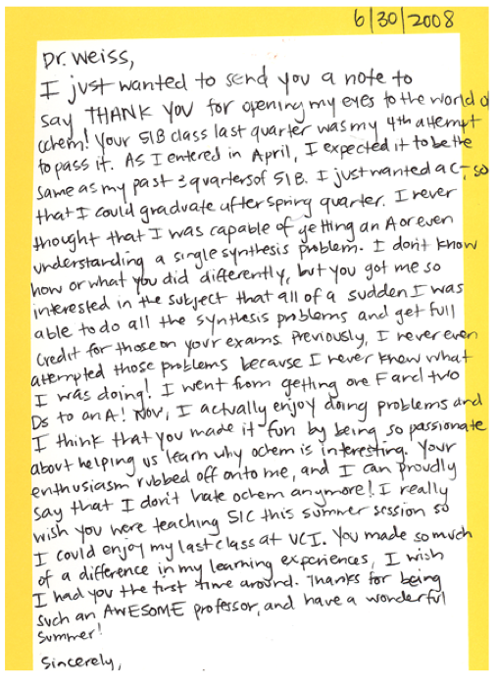
The divergent experiences of previous Chem 51 students
From ratemyprofessor.com:
Damn you idiots who said you can Ace the test by memorizing the answers. You screwed us over. You ****ing r****…

Slide 18
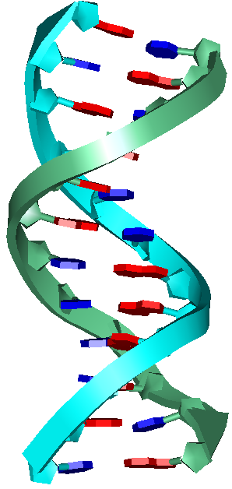
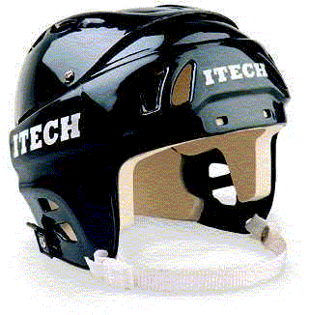
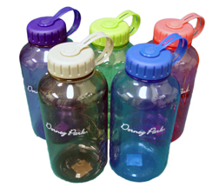
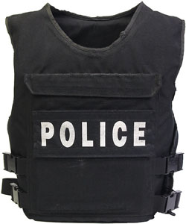
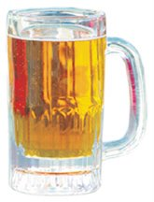
Chem 51A: Develop tools to address the big questions
How did life begin?
What are the characteristics of life?
How can we control and understand the world around us?

Slide 19

Why does o-chem matter… to healthcare workers?
Pharmaceuticals = chemicals
Also o-chem builds skills in
Observations
Fitting observations to database of knowledge
Making hypothesis
Testing hypothesis

Slide 20

Why does o-chem matter… to healthcare workers?
O-chem builds skills in
Making observations
Fitting observations to database of knowledge
Forming hypotheses
Testing hypotheses
Develop such skills without…
killing patients.

Slide 21
Why does o-chem matter… to a physician?
The pharmaceuticals prescribed
Organic chemicals
The biochemical mechanisms treated
Organic chemistry
Need to understand these without…
killing patients.

Slide 22
Why does o-chem matter… to a physician?
JAMA, January 3, 2007—Vol 297, No. 1, p. 37.
To the Editor: In his Commentary, Dr Emanuel rightly calls for reform in the premedical curriculum, much of which could be more intelligently shaped in response to the evolving challenges in medicine. However, I would not so hastily dismiss organic chemistry as a mere tool to thin the applicant herd. Indeed, I believe that no other premedical course so directly impacts clinical practice. In a well-taught course, the specific facts of organic chemistry are secondary to the skills of pattern recognition, systematic analysis of complex problems, thinking in 3 dimensions, and the application of rules and techniques to new situations. Students must break down imposing reactions into their component parts—synthesis, mechanism, stereochemistry, and regiochemistry—and search for recognizable patterns with which to unravel the solution. I do not believe that any other premedical course demands such rigor in critical thinking. At its best, organic chemistry is learned as a language, with its own rules, vocabulary, symbols, and patterns. Students are asked to speak, read, write, and create in 3 dimensions. It is intimidating and difficult precisely because memorization alone is not enough: students must master the application of familiar patterns and tools to new situations. These skills are essential in clinical medicine. Patient presentations, like organic reactions, have a wide array of variations. Every time I interview a new patient or respond to a midnight emergency, I search for patterns and apply the rules and techniques I have learned. Medicine has its own language, with grammar and method trainees must master in order to become clinicians. More complicated or dire cases only heighten the importance of an organized, systematic, and creative approach. I remember very little about benzene rings, but the critical thinking and problem-solving skills of organic chemistry formed the foundation of my medical training. Daniel B. Kramer, MD dbkramer@partners.org Department of Medicine Massachusetts General Hospital Boston, Massachusetts

Slide 23
Our story on Monday…
Electrons are in s- and p-orbitals
S-orbitals are more stable, as electrons are closer to the nucleus
Bonds indicate transfer of electrons
Ionic for very different electronegativities and full transfer of electrons to form salts
Covalent for electrons shared between two atoms

Slide 24
Our story on Wednesday…
Lewis structures
Simply insure every 2nd row element has a complete octet
Count electrons
Assign formal charge
Resonance stabilizes molecules
Avoid charge separation
Move electrons, not atoms

Slide 25
Our story on Friday...
Resonance structures stabilize charge
Draw line / skeletal organic structures
Do not use condensed or written out structures on midterms or final exam
Bond lengths and bond angles are predictable based on # of attached groups and lone pairs repulsion

Slide 27
Electrons hang out in orbitals
Closer to the nucleus increases stability

Slide 29
The Elements of Organic Chemistry
We’ll see these all quarter
Learn their valence and bonding

Slide 31
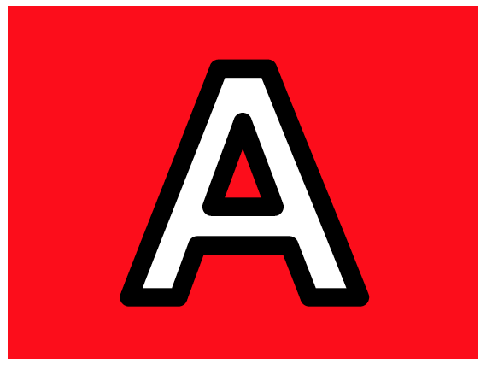
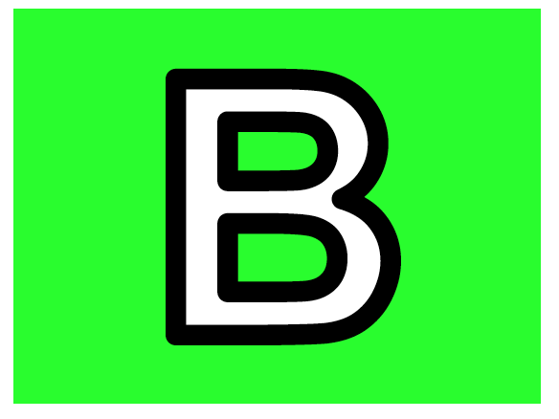
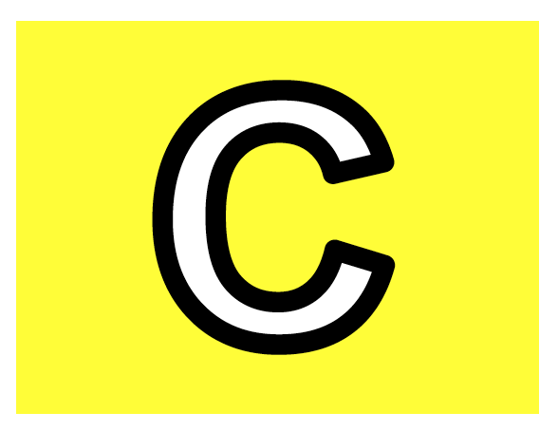
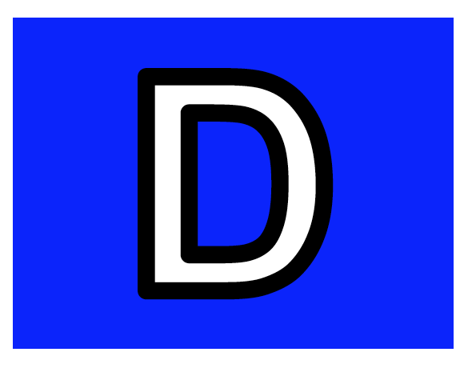
Who’s the most electronegative?
Boron (B)
Carbon (C)
Sodium (Na)
Fluorine (F)

Slide 33
Bonding = joining of two atoms through a shared e⁻
Complete the octet

Slide 35
Two kinds of bonds
Covalent and ionic

Slide 36
Monday: quick review of octet
Every atom wants a complete octet

Slide 37
Which carbon atom has a complete octet?

Slide 38
Rules for Lewis Structures
Mandatory. No exceptions.

Slide 41
How to draw Lewis Structures
Follow these steps!

Slide 43
Multiple bonds
Use the number of H’s associated with each C to guide you

Slide 45
Which is a correct Lewis structure C₆H₁₂

Slide 46
Formal Charge
Essential. Must not omit.

Slide 48
What is the formal charge of nitrogen in NH₄?
+1
+2
-1
0

Slide 49
Isomers
Same molecular formula, different structure

Slide 51
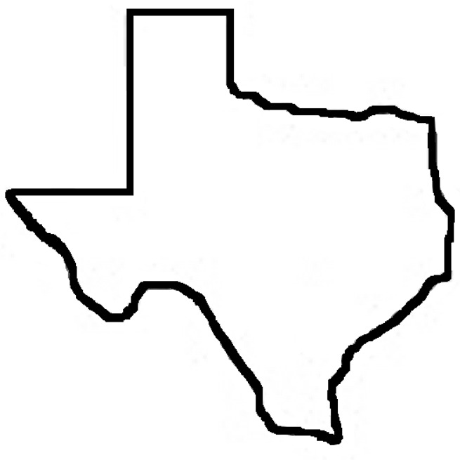
Exceptions to the Octet Rule
Will never, ever, ever see C with five bonds
C

Slide 53
Resonance
Molecules often blend more than one resonance structure.

Slide 55
Drawing resonance structures
We’ll use curly arrows extensively to indicate the movement of electron pairs
Keep the atoms in place, just move the electrons

Slide 56
Which resonance structure is best?
Carbon dioxide

Slide 57
Choosing the best resonance structures
Minimize charge separation
Most stable = best

Slide 59
Which is the major resonance structure of 4-nitrophenol?

Slide 60
Visualizing 3D molecules
Start with correct Lewis structure
Add bond lengths and atomic orbitals

Slide 62
Bond Lengths
Correlate with bond strength

Slide 64
Bond Angles
Arrange atoms to maximize distance from each other and lone pairs

Slide 66
Drawing Organic Structures
Condensed structures used extensively

Slide 68
Which is a correct Lewis structure for CH₃COCH₃

Slide 69
Line or skeletal structures
Must master this quickly

Slide 71
What’s the best structure of C₆H₆?

Slide 72
Charges on C
Carbon reluctantly accepts charge (+ & -)

Slide 74
What’s the smallest bond angle?

Slide 75
Combine atomic orbitals to form molecular orbitals
Hydrogen structure

Slide 77
Methane structure
Hybrid s & p orbitals give us sp³ orbitals around C

Slide 79
More hybrid orbitals
Pay attention to s-character
Determines many important properties

Slide 81
Which lone pair (l.p.) has the most s-character?

Slide 82
Ethane, ethylene & acetylene
Yay! Now we’re cooking with gas…

Slide 84
Bond strength and length
Inversely correlated

Slide 86
Electronegativity
Key determinant of reactivity
Will come up repeatedly this quarter (and the next two)

Slide 88
Electronegativity and bond polarity
Who wants the electrons?

Slide 90
Polarity of molecules
An often over-looked concept, which appears in biology, biochemistry, & chemical biology

Slide 92
Which compound has the biggest dipole?

Slide 93
Defining Acidity and Basicity
Brønsted-Lowry definition governs proton donation (acid) and acceptance (base)

Slide 95
Organic compounds as acids and bases
Can have both basic and acidic functionalities in the same structure

Slide 97
Who’s the acid and who’s the base?

Slide 98
The proton transfer reaction
Using curly arrows to show movement of electrons
A simple reaction used very often in o-chem

Slide 100
Some important conventions in o-chem
These will come up often

Slide 102
The pK_{a} scale
We will tell you when to memorize values
More important (for now) = meaning

Slide 104
What does a bigger (or smaller pK_{a} value mean?
An indication of relative protonation strength on a log scale

Slide 106
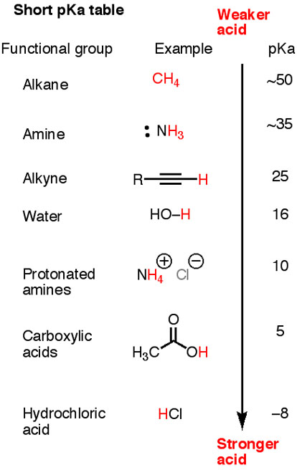
Compare with Table 2.1

